Slide 1
Introduction to IOT
G.Mallikarjuna Rao

Slide 2
Syllabus
Unit III
Introduction To Internet of Things: Introduction, Physical Design of IoT, Logical Design of IoT, IoT enabling Technologies, IoT Levels and Deployment Templates
Domain Specific IoTs: Introduction, Home Automation, Smart Cities, Environment, Energy, Retail, Logistics, Agriculture, Industry, Health and LifeStyle
UNIT IV
IoT Systems- Logical Design Using Python: Introduction, Installing python, Python data types and data structures, Control Flow, Functions, Modules, Packages, File Handling, Date/ Time operations, Classes, Python Packages of Interest for IoT.
IoT Physical Devices And End Points: IoT Device, Exemplary Device: Raspberry Pi, About the board, Linux on Raspberry Pi, Raspberry Pi Interfaces, Programming Raspberry Pi with Python

Slide 3
Physical Design of IOT
Physical Design of IoT refers to IoT Devices and IoT Protocols. Things are Node device which have unique identities and can perform remote sensing, actuating and monitoring capabilities. Communication established between things and cloud based server over the Internet by various IoT protocols.
Things refers to IoT Devices and are the main part of IOT application. They have unique identities with remote sensing, actuating and monitoring capabilities.
IoT Devices can be various type, Sensing Devices, Smart Watches, Smart Electronics appliances, Wearable Sensors, Automobiles, and industrial machines. These devices generate data in some forms or the other which when processed by data analytics systems leads to useful information to guide further actions locally or remotely.

Slide 4
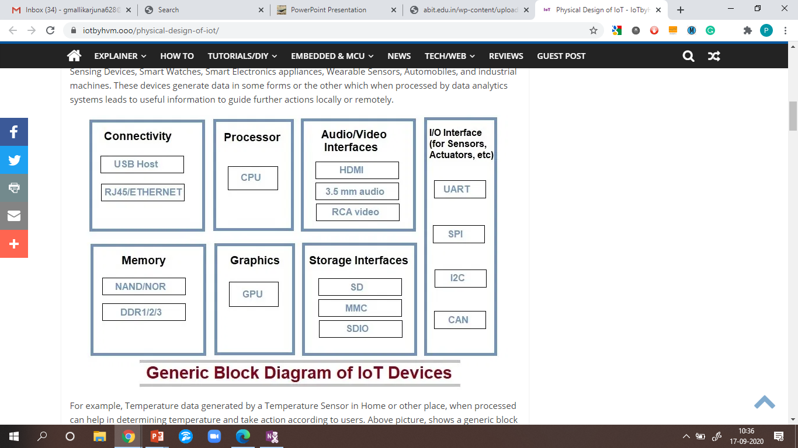
Generic Block Diagram of IOT Devices

Slide 5
Example
For example, Temperature data generated by a Temperature Sensor in Home or other place, when processed can help in determining temperature and take action according to users. Generic block diagram of IoT device may consist of several interfaces for connections to other devices. IoT Device has I/O interface for Sensors, Similarly for Internet connectivity, Storage and Audio/Video. IoT Device collect data from on-board or attached Sensors and Sensed data communicated either to other device or Cloud based sever. Today many cloud servers available for especially IoT System. These Platfrom known as IoT Platform. Actually these cloud especially design for IoT purpose. So here we can analysis and processed data easily.
How it works ? For example if relay switch connected to an IoT device can turn On/Off an appliance on the commands sent to the IoT device over the Internet.

Slide 6
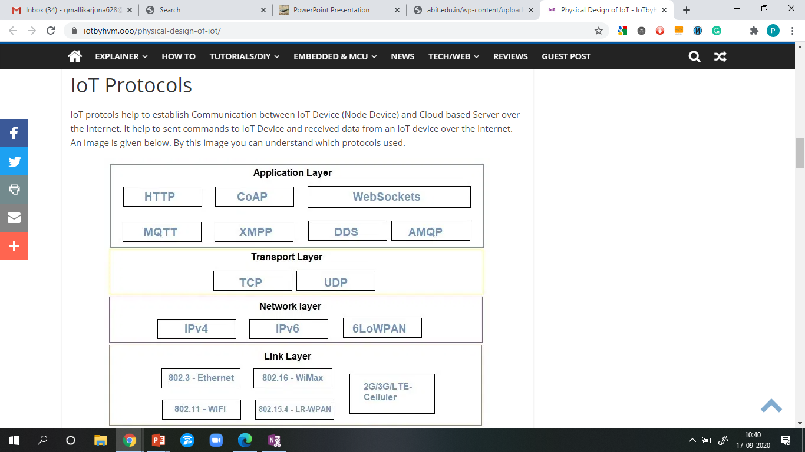

Slide 7
Link Layer
Link layer protocols determine how data is physically sent over the network’s physical layer or medium (Coxial calbe or other or radio wave). This Layer determines how the packets are coded and signaled by the hardware device over the medium to which the host is attached (eg. coxial cable). Here we explain some Link Layer Protocols:
802.3 – Ethernet : Ethernet is a set of technologies and protocols that are used primarily in LANs. It was first standardized in 1980s by IEEE 802.3 standard. IEEE 802.3 defines the physical layer and the medium access control (MAC) sub-layer of the data link layer for wired Ethernet networks.
802.11 – WiFi : IEEE 802.11 is part of the IEEE 802 set of LAN protocols, and specifies the set of media access control (MAC) and physical layer (PHY) protocols for implementing wireless local area network (WLAN). Most of Wi-Fi computer communication in 2.4 GHz, 5 GHz, and 60 GHz frequency bands.

Slide 8
Link Layer
802.16 – Wi-Max : The standard for WiMAX technology is a standard for Wireless Metropolitan Area Networks (WMANs) that has been developed by working group number 16 of IEEE 802, specializing in point-to-multipoint broadband wireless access.
802.15.4 -LR-WPAN : A collection of standards for Low-rate wireless personal area network. The IEEE’s 802.15.4 standard defines the MAC and PHY layer and low-cost and low-speed communication for power constrained devices.
Ex Zigbee®, 6LoWPAN, Thread, WiSUN and MiWi™ protocols.
2G/3G/4G- Mobile Communication : These are different types of telecommunication generations. IoT devices are based on these standards can communicate over the cellular networks.

Slide 9
Network Layer
Responsible for sending of IP datagrams from the source network to the destination network. Network layer performs the host addressing and packet routing.IPv4 and IPv6 for Host identification(hierarchical IP addressing schemes).
IPv4 : An Internet Protocol address (IP address) is a numerical label assigned to each device connected to a computer network that uses the Internet Protocol for communication. An IP address serves two main functions: host or network interface identification and location addressing. Example:192.1.16.134
Internet Protocol version 4 (IPv4) defines an IP address as a 32-bit number. However, because of the growth of the Internet and the depletion of available IPv4 addresses, a new version of IP (IPv6), using 128 bits for the IP address, was standardized in 1998. IPv6 deployment has been ongoing since the mid-2000s.

Slide 10
Network Layer
IPv6 : Internet Protocol version 6 (IPv6) is successor of IPv4. IPv6 was developed by the Internet Engineering Task Force (IETF) to deal with the long-anticipated problem of IPv4 address exhaustion IPv6 uses a 128-bit address, theoretically allowing 2¹²⁸, or approximately 3.4×10³⁸ addresses.
6LoWPAN : It is an acronym of IPv6 over Low-Power Wireless Personal Area Networks. 6LoWPAN is the name of a concluded working group in the Internet area of the IETF. This protocol allows for the smallest devices with limited processing ability to transmit information wirelessly using an internet protocol.

Slide 11
Transport Layer
This layer provides functions such as error control, segmentation, flow control and congestion control. So this layer protocols provide end-to-end message transfer capability independent of the underlying network.
TCP : TCP (Transmission Control Protocol) is connection oriented protocol. It denote the standard that defines how to establish and maintain a network conversation required for data exchange between application programs. TCP works with the Internet Protocol (IP) for sending data packets between them. Together, TCP and IP are the basic rules defining the Internet.
UDP : User Datagram Protocol (UDP) is a Transport Layer protocol. UDP is a part of Internet Protocol suite, referred as UDP/IP suite. Unlike TCP, it is unreliable and connectionless protocol. So, there is no need to establish connection prior to data transfer.

Slide 12
Application Layer
Application layer protocols define how the applications interface with the lower layer protocols to send over the network.
HTTP : Hypertext Transfer Protocol (HTTP) is an application-layer protocol for transmitting hypermedia documents, such as HTML. It was designed for communication between web browsers and web servers. HTTP follows a classical client-server model, with a client opening a connection to make a request, then waiting until it receives a response. HTTP is a stateless protocol, meaning that the server does not keep any data(state) between two requests.
CoAP : CoAP-Constrained Application Protocol is a specialized Internet Application Protocol for constrained devices, as defined in RFC 7252. It enables devices to communicate over the Internet. The protocol is especially targeted for constrained hardware such as 8-bits microcontrollers, low power sensors and similar devices that can’t run on HTTP.

Slide 13
Application Layer
WebSocket : The WebSocket Protocol enables two-way communication between a client running untrusted code in a controlled environment to a remote host that has opted-in to communications from that code.
MQTT : MQTT is a machine-to-machine (M2M)/”Internet of Things” connectivity protocol. It was designed as an extremely lightweight publish/subscribe messaging transport and useful for connections with remote locations where a small code footprint is required and/or network bandwidth is at a premium.
XMPP : Extensible Messaging and Presence Protocol (XMPP) is a communication protocol for message-oriented middleware based on XML (Extensible Markup Language). It enables the near-real-time exchange of structured yet extensible data between any two or more network entities.

Slide 14
Application Layer
DDS : The Data Distribution Service (DDS™) is a middleware protocol and API standard for data-centric connectivity from the Object Management Group® (OMG®). It integrates the components of a system together, providing low-latency data connectivity, extreme reliability, and a scalable architecture that business and mission-critical Internet of Things (IoT) applications need.
AMQP : The AMQP – IoT protocols consist of a hard and fast of components that route and save messages within a broker carrier, with a set of policies for wiring the components together. The AMQP protocol enables patron programs to talk to the dealer and engage with the AMQP model.

Slide 15
Embedded Technologies
Unit III

Slide 16
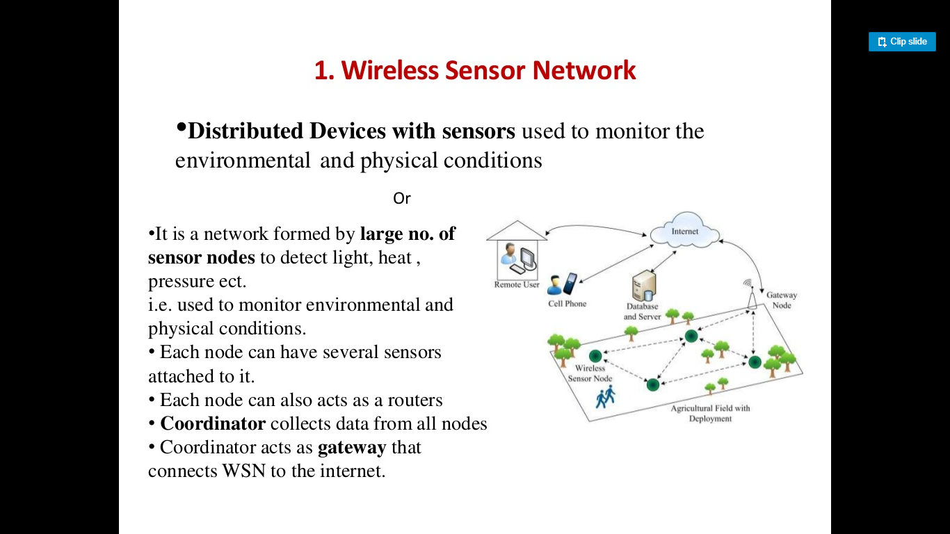

Slide 17
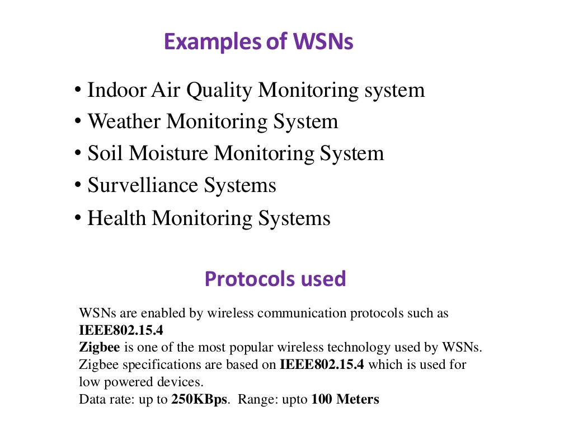

Slide 18
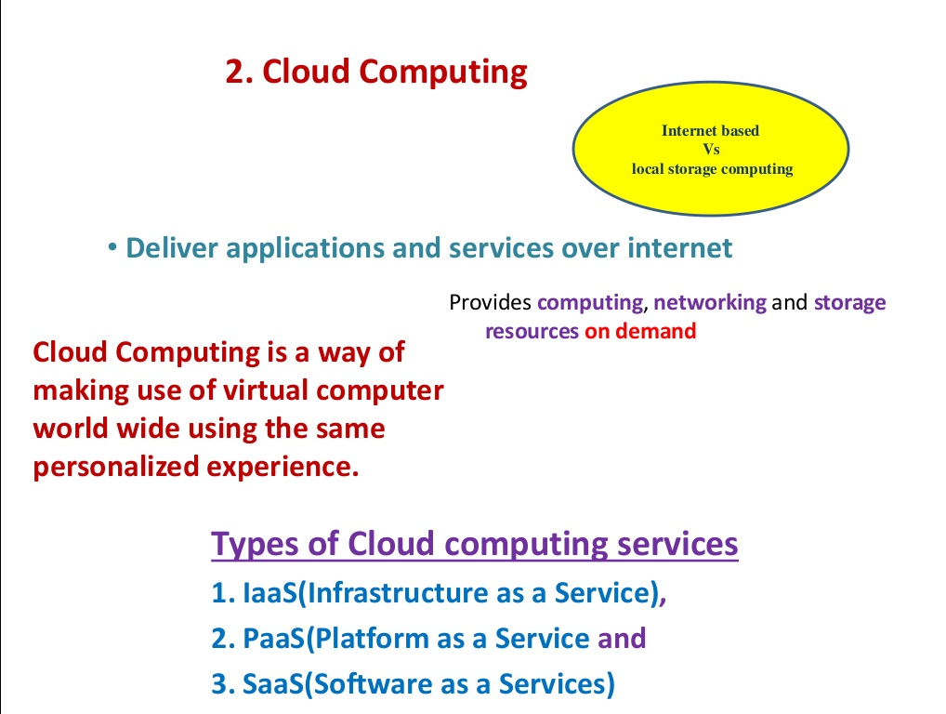

Slide 19
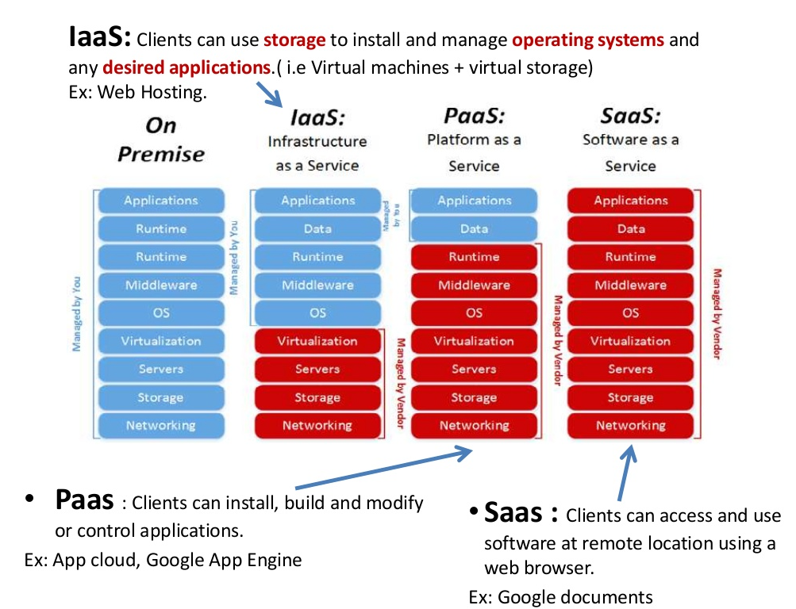

Slide 20
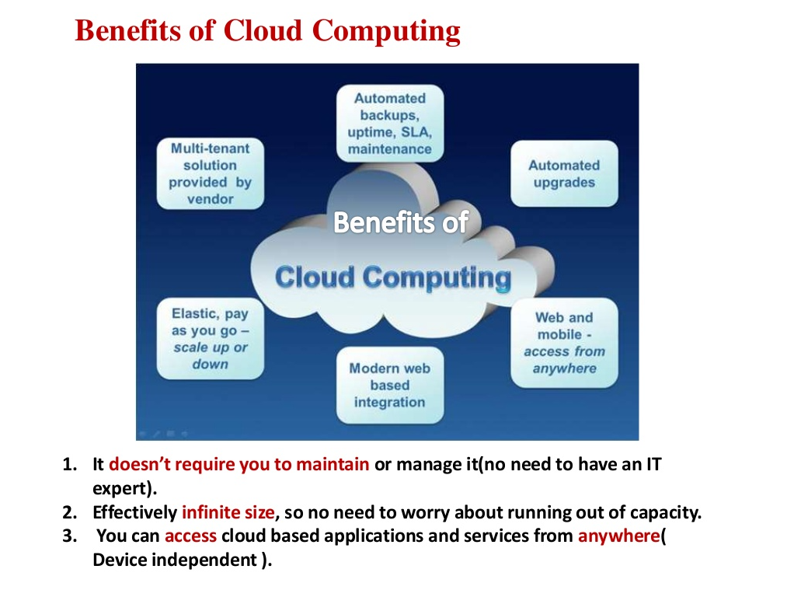

Slide 21
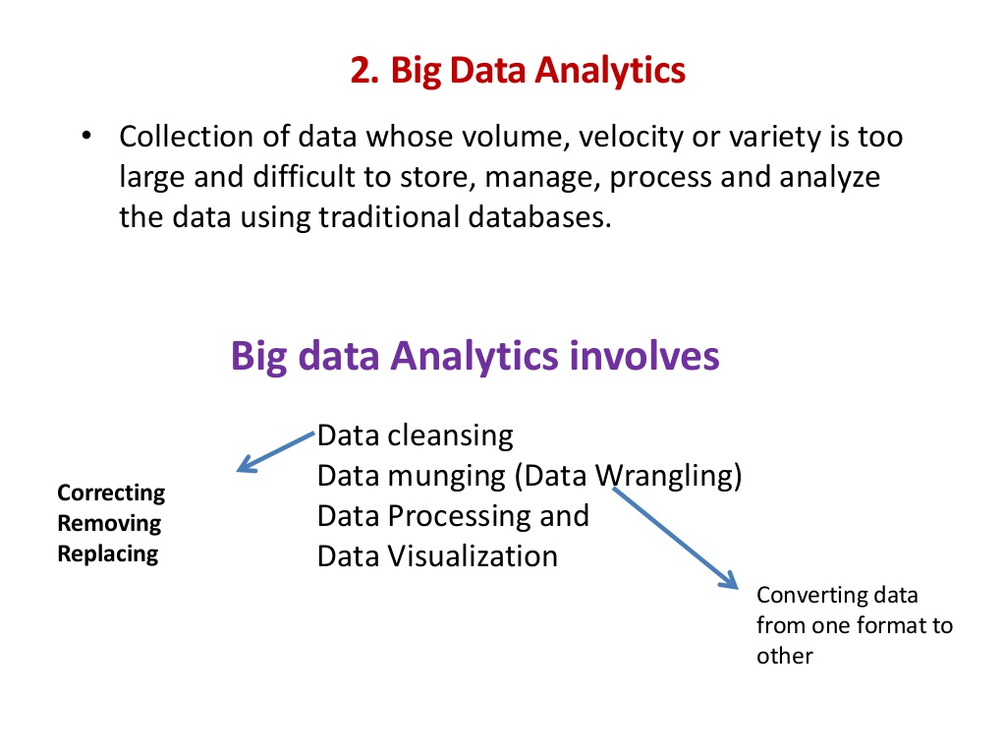

Slide 22
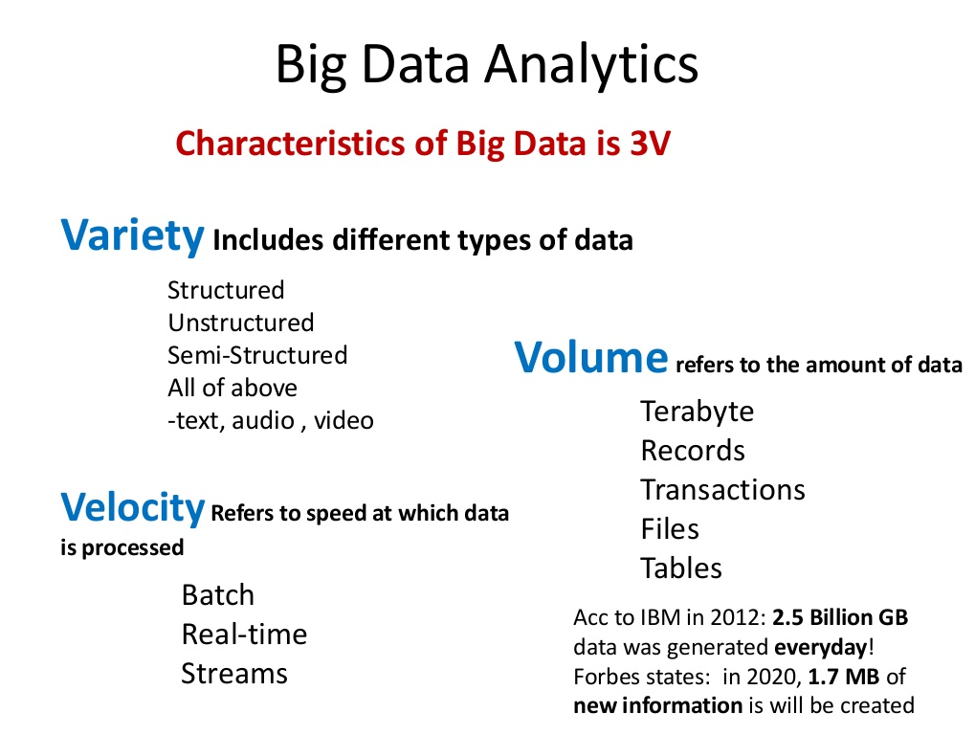

Slide 23
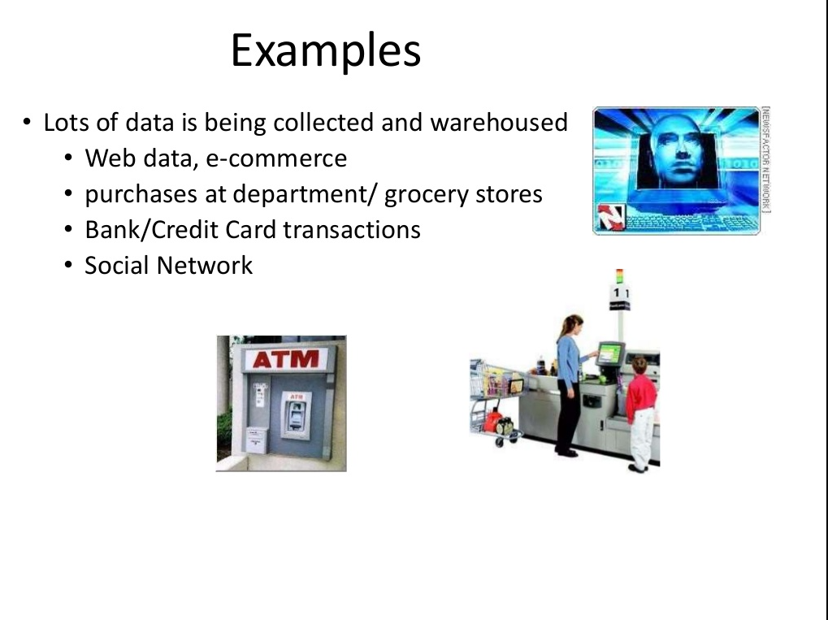

Slide 24
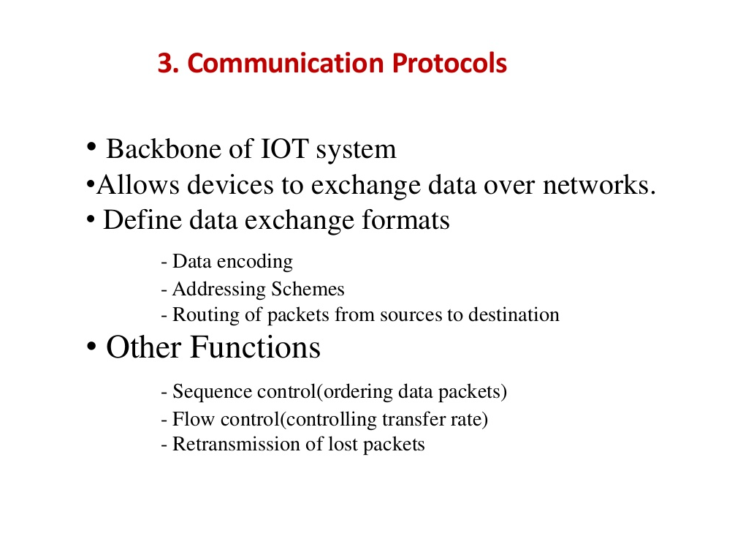

Slide 25
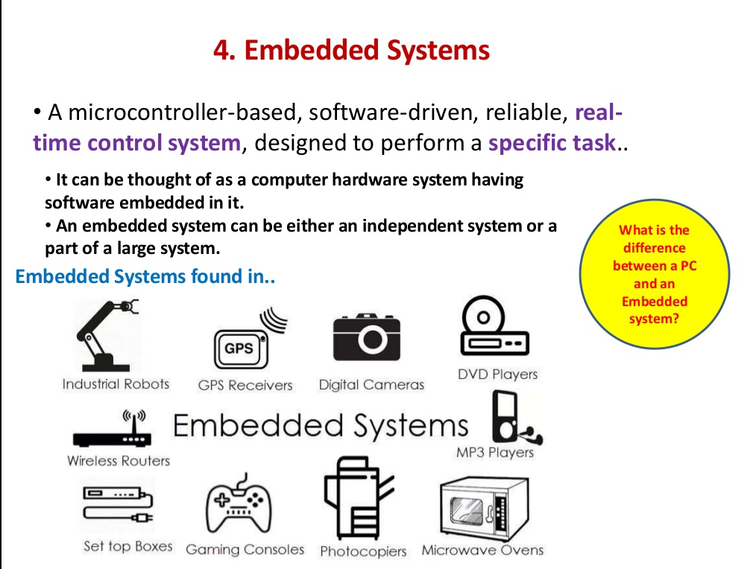

Slide 26
